Slide 1

BBC News
By: Diego Deviez
Notes:
I did my computational visual analysis and topic modeling using BBC News to further analyze current news topics.

Slide 2
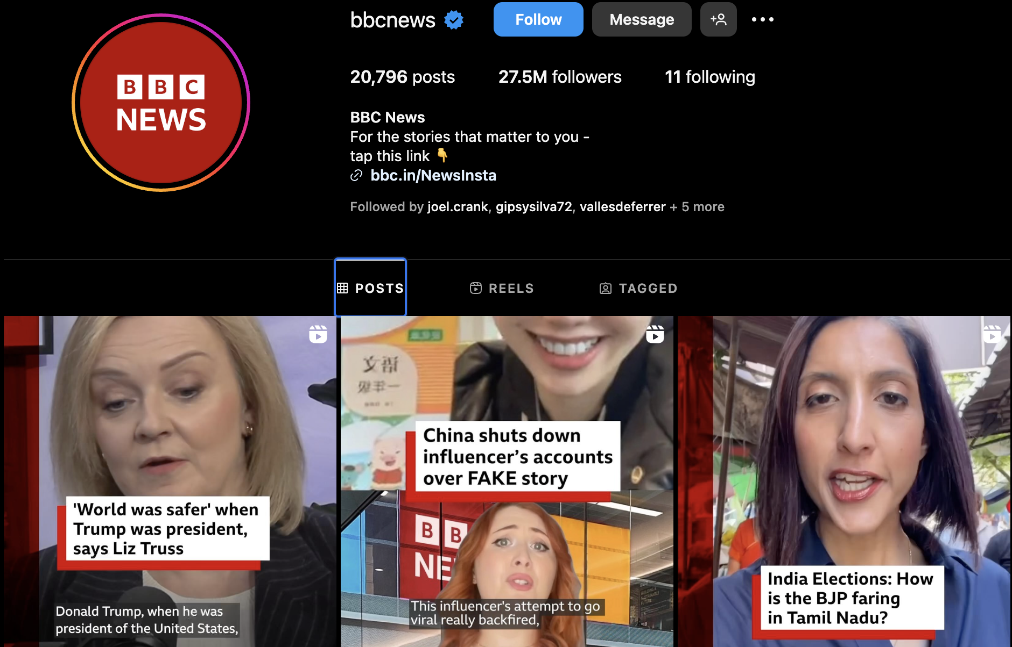

Data Source and Collection Procedures
Posts were extracted from Instagram
4K Stogram – collection of visual posts (Past 2 months)
489 images downloaded
Infegy – collection of posts (Past 2 months)
338 total posts extracted onto a spreadsheet (letter, sentiment, wordcount)
Notes:
Using Instagram as my social media platform, I was able to obtain large collections of images and text from the past 2 months.
I used 4K Stogram platform to extract a total of 489 visual posts from BBC news Instagram.
I used Infegy platform to extract a total of 338 posts from BBC news Instagram captions onto an excel file which contained the whole caption, sentiment of each post, and wordcount.
Using this I was able to do so minor analysis, I found that the post’s had an average wordcount of 93 and that 56% of them had positive sentiment.

Slide 3
Methods – Computational Visual Analysis
Using the downloaded images, I was able to use google colab to run programs for:
Face++ face detection and analysis to uncover characteristics and attributes (number of faces, gender, age, and emotion) of the images
Aesthetic analysis to derive the HSV (Hue, Saturation, and Value) of the images
Image Clustering

Slide 4
Findings & Dataset Descriptions – Face++ & Aesthetic Results
Face++ Results – 489 images
Total number of faces: 449
Average Age: 41.2
Male: 259, Female: 190
Aesthetic Results – 489 images
Average Hue: 56.5
Average Saturation: 84.2
Average Value: 115.3
Notes:
The program results were all outputted onto an Excel file, which I then used to calculate and derive these findings.
Neutral Makes sense for a news Outlet.

Slide 5
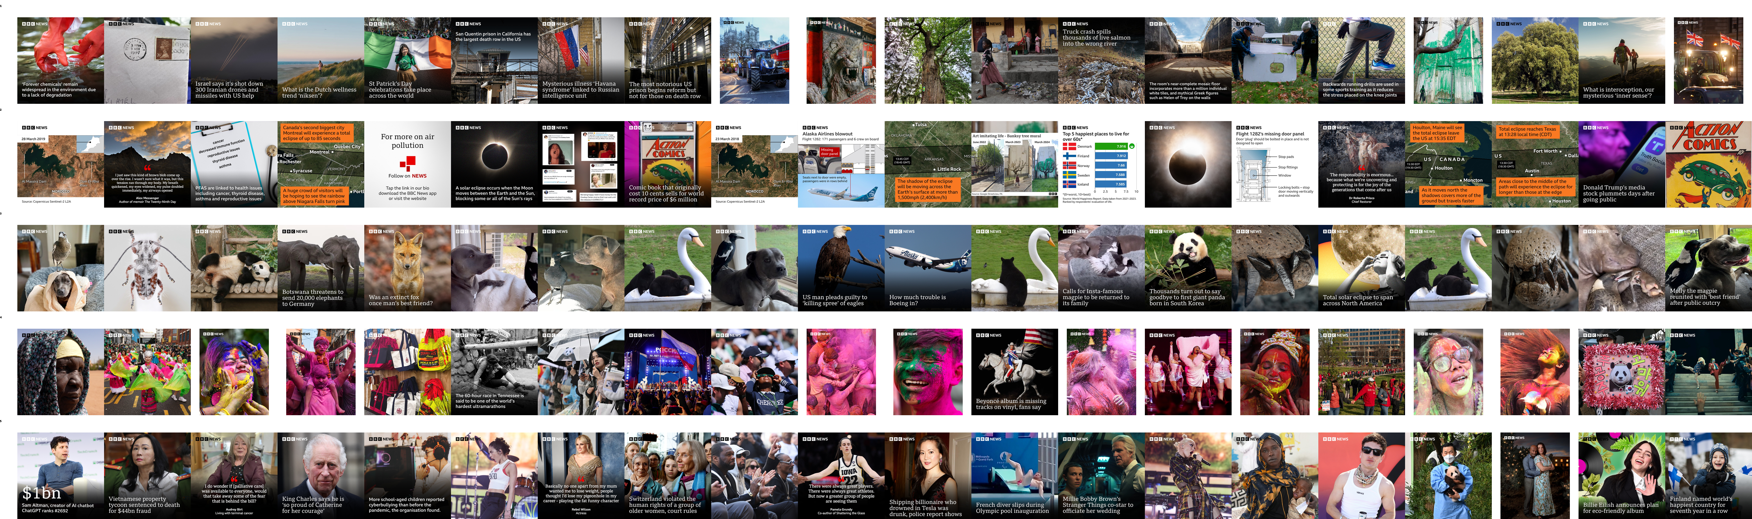
Methods – Image Clustering
Using Google Colab:
Performed a feature extraction using a pretrained model
Conduct Principal Component Analysis on the extracted features
Run K-Means clustering
Randomly select images from each cluster to inspect themes
Visualized these random selections in a grid
Notes:
Final part of my computational visual analysis: image clustering

Slide 6
Findings & Dataset Descriptions – Image Clustering
The pretrained Model returned 5-10 cluster solutions (grouping)
Used cluster solutions datasets to evaluate the distribution of images within each of the cluster solutions
The 5-cluster solution had a more even distribution compared to the other solutions
Notes:
Cluster solutions refer to the grouping of images into distinct clusters based on their visual similarity or other features
This even distribution led me to further analyze the 5-clustering solution.

Slide 7
Global News
Geographical Differences
Wild Encounters
Colorful Cultures
Public Figures in the Spotlight
Notes:
Here is a visualization of the 5-cluster solution.
You can the many similarities among the images within each cluster.
This, along with its more even distribution, led me to believe that that the 5-Cluster Solution was the best representation of the whole sample.

Slide 8
Methods – Topic Modeling
Used the excel file containing the extracted posts, I was able to:
Analyze the documents and covariates(sentiment)
Create plots to help make an informed decision on the optimal number of topics
Build a model to create different datasets to help me further analyze the optimal number of topics created
Notes:
Datasets (doc-topic matrix, estimateEffects, key word document)

Slide 9
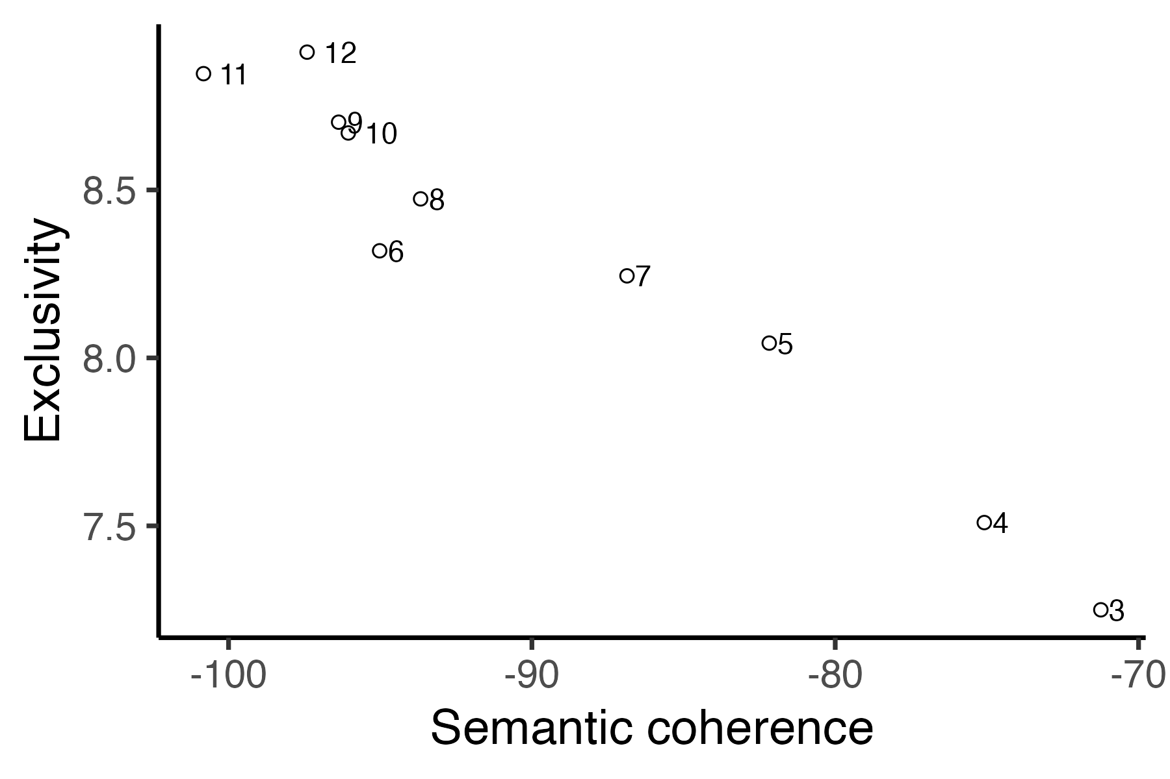
Findings & Dataset Descriptions - Semantic & Exclusivity
Notes:
Having too few topics can make themes too broad, but having too many can cause fragmentation and repetition. The optimal number of topics displays a balance between semantic coherence and exclusivity.
With this in mind, I felt like 7 was the optimal number of topics.

Slide 10
Findings & Dataset Descriptions - Topic Keywords
Topic 1 link, tap, bio, find, said, show, getti, can, read, month, dune, star, say, will, one, film, scientist, home, use, like
Topic 2 link, bio, tap, find, moon, said, read, will, trump, year, donald, time, state, see, bbcnewss, biden, republican, getti, alabama, last
Topic 3 bio, tap, link, said, film, bafta, award, see, getti, year, read, best, star, british, fan, actor, play, one, night, first
Topic 4 said, bio, tap, link, find, one, report, read, bbcnewss, new, time, getti, famili, year, known, will, museum, line, miss, four
Topic 5 bio, link, tap, peopl, read, fire, kill, bbcnewss, said, gaza, rescu, attack, bridg, baltimor, two, call, find, israel, least, polic
Topic 6 link, bio, tap, year, said, world, getti, read, will, million, peopl, student, tree, find, last, debt, bbcnewss, new, hear, announc
Topic 7 said, link, tap, bio, read, putin, russia, will, presid, one, getti, new, prison, servic, bbcnewss, russian, made, sinc, countri, navalni
Notes:
To further examine these 7 topics, we can look the keyword output that contains a list of keywords relevant to the topics.
This gives use a better understanding of each topic.
Could have added more stop words, “link”, ”bio”, “tap”, ”read”, “said”, and I did use versions of bbcnews as stop words just not one with two “ss”.

Slide 11
Topic 1: Sci-Fi Films and Science (16%) link, tap, bio, find, said, show, getti, can, read, month, dune, star, say, will, one, film, scientist, home, use, like
Topic 2: Political News (14%) link, bio, tap, find, moon, said, read, will, trump, year, donald, time, state, see, bbcnewss, biden, republican, getti, alabama, last
Topic 3: Film Industry Awards (14%) bio, tap, link, said, film, bafta, award, see, getti, year, read, best, star, british, fan, actor, play, one, night, first
Topic 4: News Reports and Updates (12%) said, bio, tap, link, find, one, report, read, bbcnewss, new, time, getti, famili, year, known, will, museum, line, miss, four
Topic 5: World Conflict, Crisis, and Rescue (20%) bio, link, tap, peopl, read, fire, kill, bbcnewss, said, gaza, rescu, attack, bridg, baltimor, two, call, find, israel, least, polic
Topic 6: Global Issues and Education (14%) link, bio, tap, year, said, world, getti, read, will, million, peopl, student, tree, find, last, debt, bbcnewss, new, hear, announc
Topic 7: Russian Politics and Current Affairs (10%) said, link, tap, bio, read, putin, russia, will, presid, one, getti, new, prison, servic, bbcnewss, russian, made, sinc, countri, navalni
Findings & Dataset Descriptions - Topic Keywords
Notes:
Using the keywords and document-topic matrix, I was able to analyze the underlying structure and the distribution of the topics and give each topic a thematic name.

Slide 12
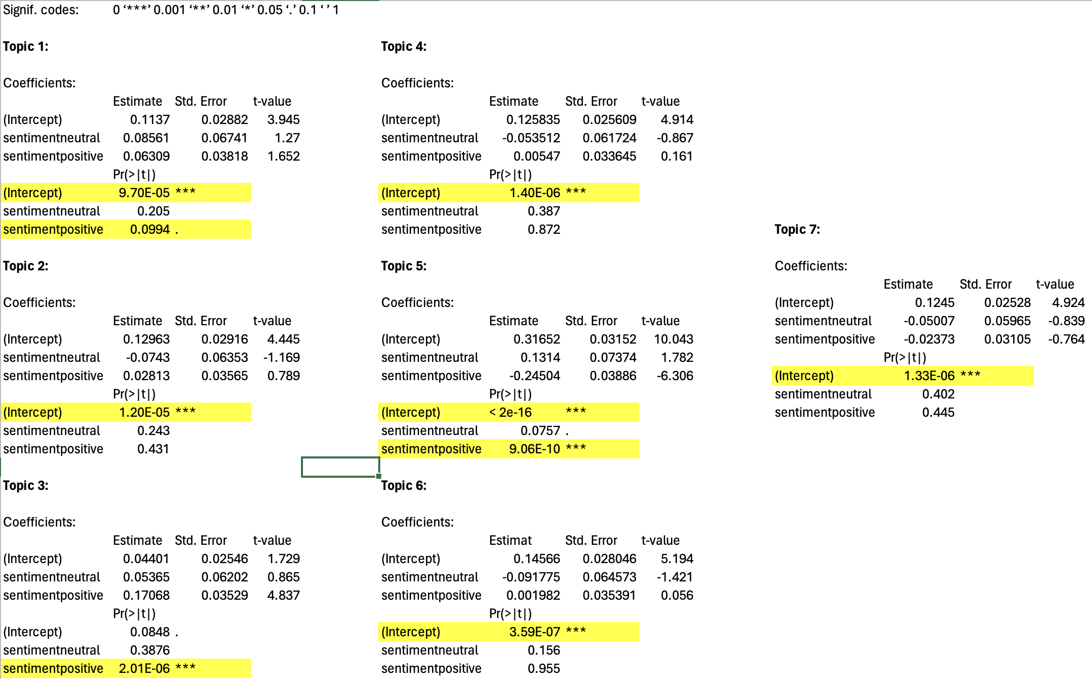
Findings & Dataset Descriptions - Effects
Notes:
'***' means highly significant (p < 0.001)
'**' means significant (p < 0.01)
'*' means marginally significant (p < 0.05)
'.' means suggestive (p < 0.1)
' ' means not significant (p ≥ 0.1)
Using the effects output, I was able to analyze my covariate (sentiment) and see if it has any impact on the outcome.
Interpreting this output involves assessing the significance of each predictor variable (sentimentneutral and sentimentpositive) based on their associated p-values.
In this case, neither sentimentneutral nor sentimentpositive seem to be highly significant predictors of the outcome, given their p-values.

Slide 13
Summary
Computational Facial Analysis:
Object Recognition and Classification
Image Clustering
Topic Modeling:
Information Retrieval
Classify a collection of documents into different “topics”
Notes:
Using Computational Facial Analysis:
I was able to analyze a large collection of images to derive certain characteristics (age, gender, emotion, Hue, Saturation, Value) about those images and obtain underlying structures through image clustering (which helped me better understand the content of the images) and pick the best clustering solution. (5)
Using Topic Modeling:
I was able to analyze a large collection of documents to discover hidden thematic structures within them. By identifying patterns of co-occurring words, I was able to create a plot to make an educated decision on the optimal number of topics. Then further analyze that number of topics using keywords, document-topic matices, and effects of my covariate on the outcome.
Overall, I was able to gain valuable insights from a large collection of images and text using many different, methods and outputs.

Slide 14
Questions?

